Slide 1
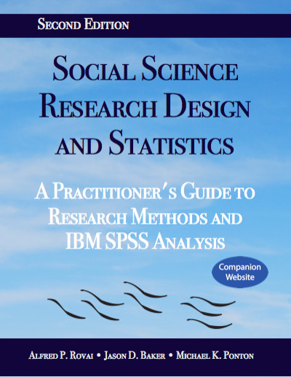
Social Science Research Design and Statistics, 2/e
Alfred P. Rovai, Jason D. Baker, and Michael K. Ponton
One-Sample T-Test
PowerPoint Prepared by
Michael K. Ponton
IBM® SPSS® Screen Prints Courtesy of International Business Machines Corporation,
© International Business Machines Corporation.

Slide 2
Uses of the One-Sample T-Test
Test the hypothesis that there is no difference between the sample mean (M) and a given population mean (μ).
Establish an estimate (i.e., a confidence interval) for the population mean.

Slide 3
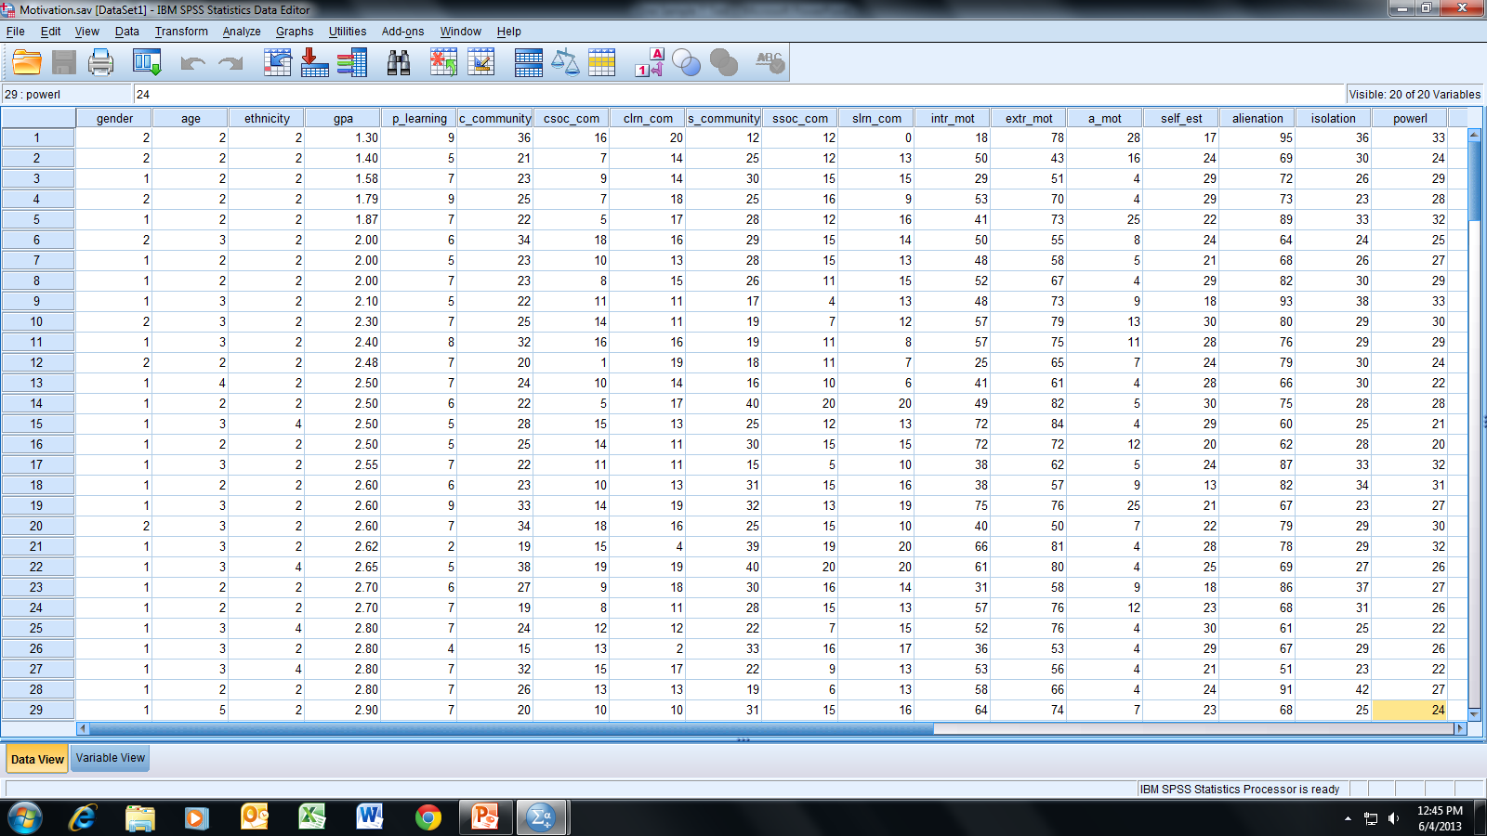
Open the dataset Motivation.sav.
File available at http://www.watertreepress.com/stats

Slide 4
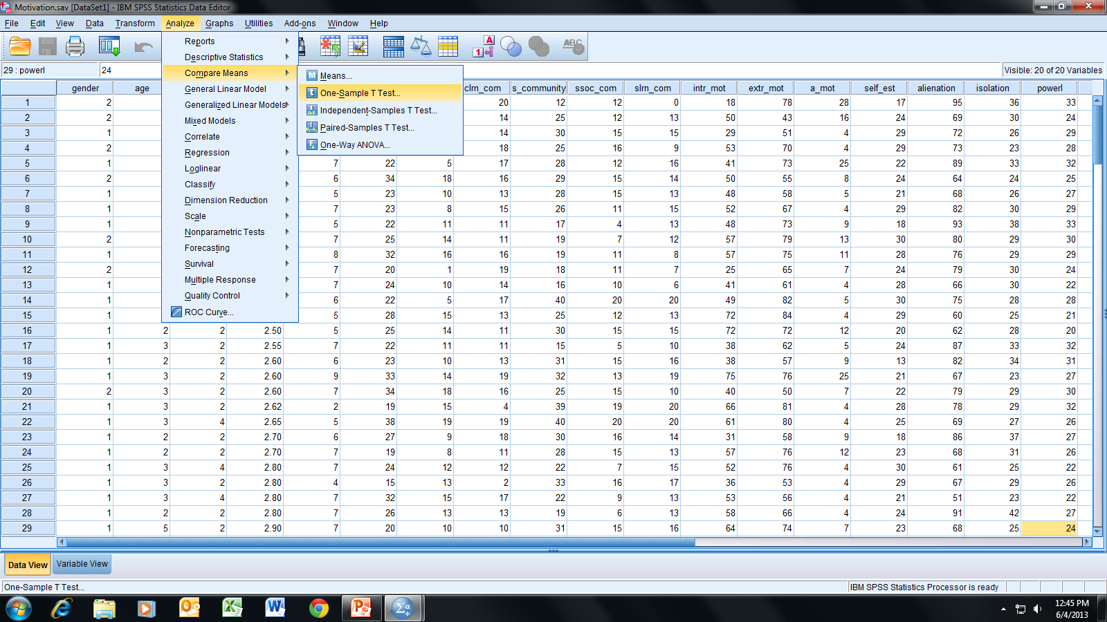
Follow the menu as indicated.

Slide 5
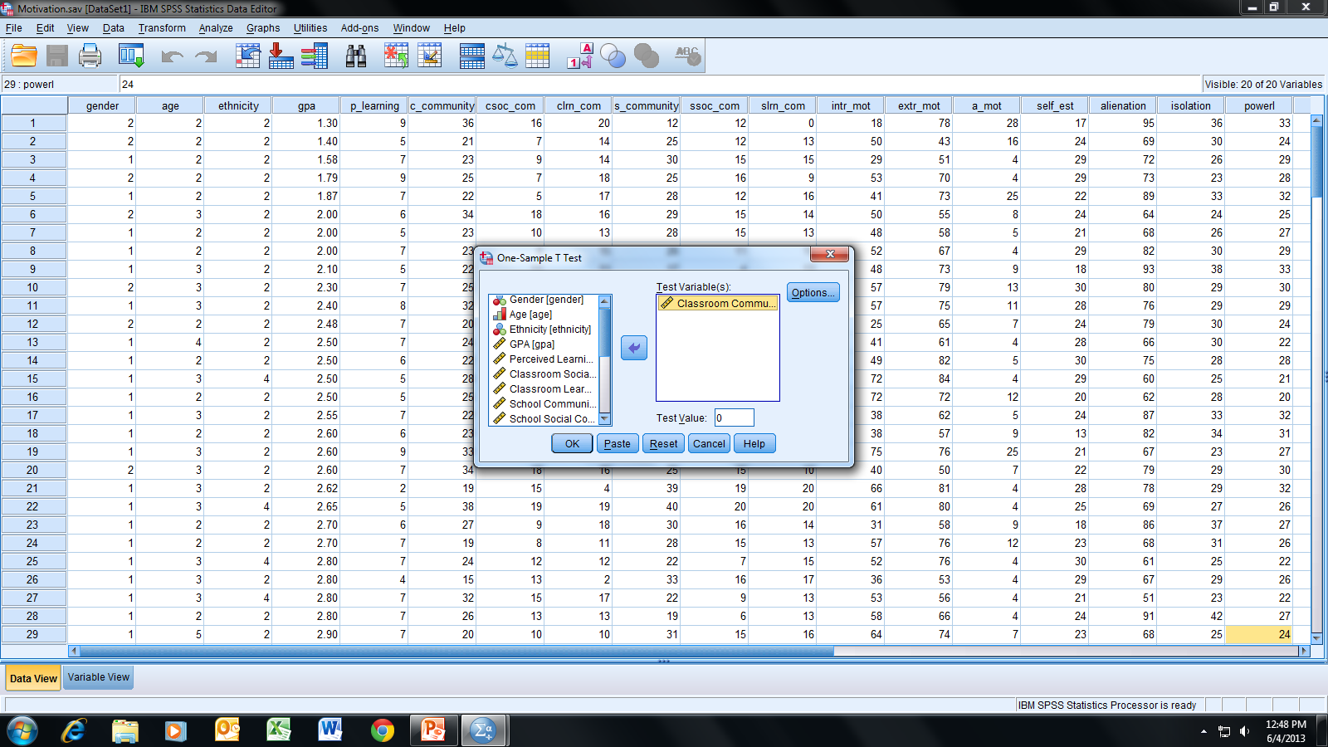
In this example, we will test the following null hypothesis:
H_{o}: There is no difference between the sample mean for
the variable Classroom Community and μ = 30.
Select and move the Classroom Community variable to the
Test Variable(s) box.

Slide 6
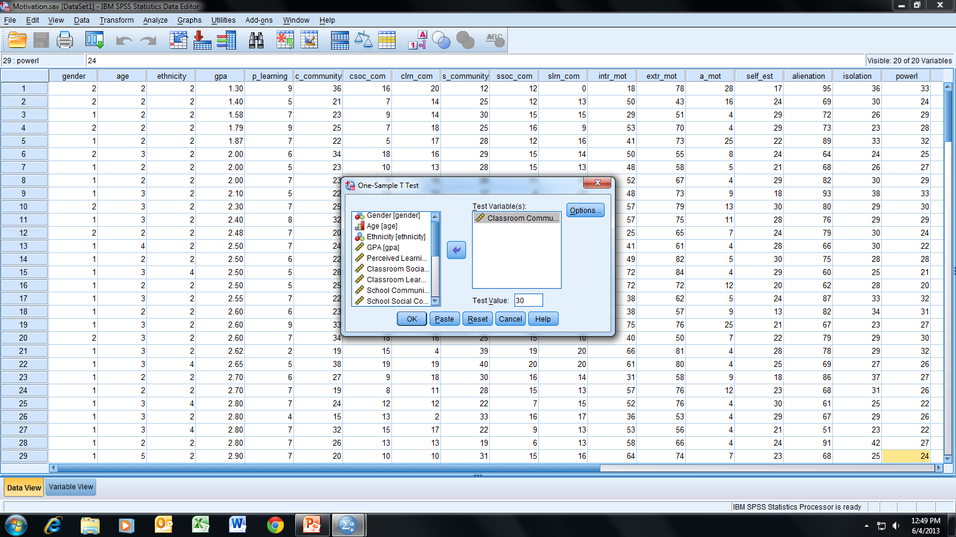
Enter 30 as the Test Value and
click OK.

Slide 7
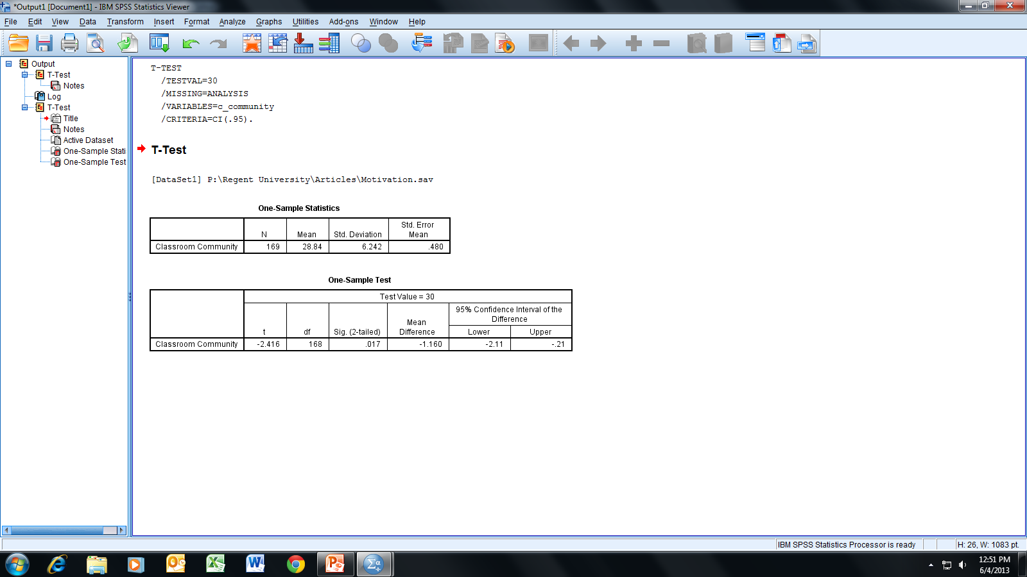
Using a two-tailed level of significance of α = .05,
we reject the null hypothesis (i.e., .017 <= .05)
and conclude there is a difference between
the sample mean and a population mean of 30.

Slide 8
We are 95% confident that the true population mean
is within the interval 27.89 and 29.79 (i.e., 30-2.11
and 30-.21); that is, CI₉₅ = (27.89, 29.79) for the
95% confidence interval.

Slide 9
End of Presentation

